Slide 2


What is HTML ?
HTML is the standard markup language for creating Web pages.
HTML stands for Hyper Text Markup Language.
HTML describes the structure of a Web page.
HTML consists of a series of elements
HTML elements tell the browser how to display the content.
HTML elements are represented by tags.
HTML Is Not Case Sensitive
Browsers do not display the HTML tags, but use them to render the content of the page

Slide 3
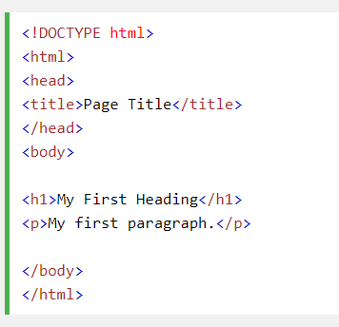
Example Explained
The <!DOCTYPE html> declaration defines this document to be HTML5
The <html> element is the root element of an HTML page
The <head> element contains meta information about the document
The <title> element specifies a title for the document
The <body> element contains the visible page content
The <h1> element defines a large heading
The <p> element defines a paragraph

Slide 4
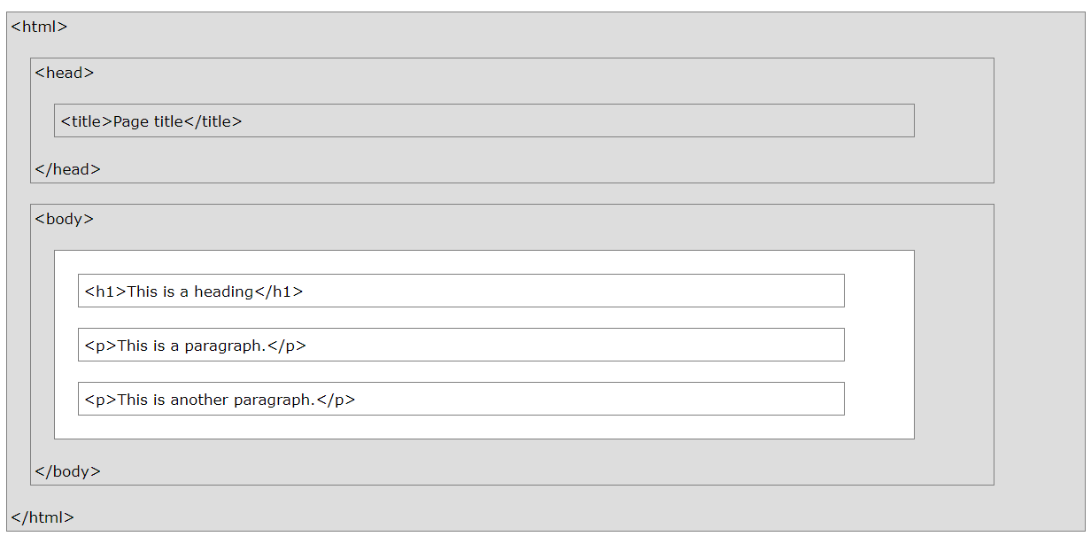
Note : Only the content inside the <body> section (the white area above) is display in a browser.

Slide 5




HTML Editors
1
2
3
4
Write Some HTML
Save the HTML Page
View the HTML Page in Your Browser
Open Notepad
Name the file
"index.htm"

Slide 6
HTML Tags
HTML tags normally come in pairs like <p> and </p>
The first tag in a pair is the start tag, the second tag is the end tag
The end tag is written like the start tag, but with a forward slash inserted before the tag name

Slide 7
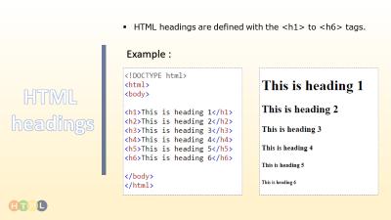
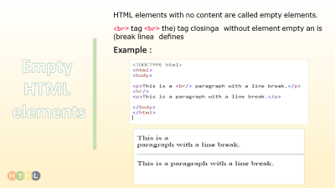
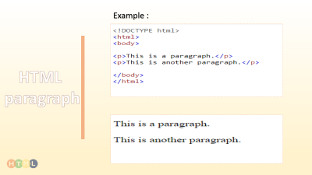
Examples of exercise

Slide 8
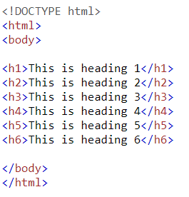
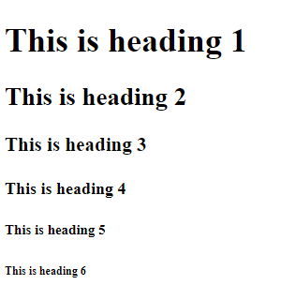
HTML headings are defined with the <h1> to <h6> tags.
Example :
HTML
headings

Slide 9
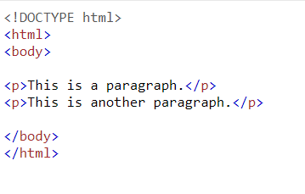
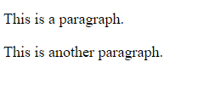
Example :
HTML
paragraph

Slide 10
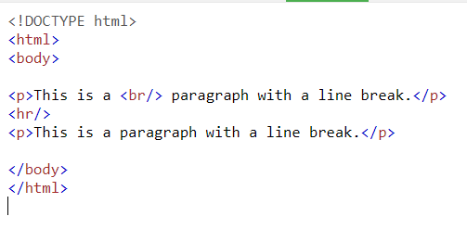
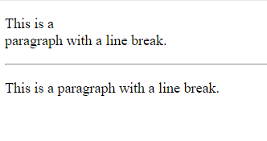
HTML elements with no content are called empty elements.
<br> is an empty element without a closing tag (the <br> tag defines a line break)
Example :
Empty
HTML
elements

Slide 11
<html> <body> <p>Hello World</p>
</body> </html>
<h1>This is a Heading</h1> <p>This is a paragraph.</p>
<h1/>
<p>My Bonnie lies<br/>over the ocean.</p>
<p>Hello World!</p>
<br/>
<p/>
Exercise1
Exercise 2
Exercise 3
Use the correct HTML tag to add a paragraph with the text "Hello World!".
Clean up this document with proper end tags.
Add a line break in the middle of the paragraph:

Slide 12
إعداد
أسماء عبدالوهاب
تقديم
بيداء الشريف
نورة الهلالي
أمجاد الجهني
شكر خاص
لمدرسة 52
وطالبات فصل (2/علمي)

